Slide 1
Artificial Intelligence (AI)
Topic 2: Problem Solving Agents (Part -IX)

Slide 2
Agenda
Hill Climbing
Genetic Algorithm
Learning Outcomes : Local Optimisation Search Algorithms
Methodology and Assessment Criteria for the Subject

Slide 3
More Search Methods
Local Search
Hill Climbing
Simulated Annealing
Beam Search
Genetic Search
Local Search in Continuous Spaces
Searching with Nondeterministic Actions
Online Search (agent is executing actions)

Slide 4
Local Search Algorithms and Optimization Problems
Complete state formulation
For example, for the 8 queens problem, all 8 queens are on the board and need to be moved around to get to a goal state
Equivalent to optimization problems often found in science and engineering
Start somewhere and try to get to the solution from there
Local search around the current state to decide where to go next

Slide 5
Pose Estimation Example
Given a geometric model of a 3D object and a 2D image of the object.
Determine the position and orientation of the object wrt the camera that snapped the image.
image 3D object
State (x, y, z, x-angle, y-angle, z-angle)

Slide 6
Hill Climbing
solution
“Gradient ascent”
Note: solutions shown
here as max not min.
Often used for numerical optimization problems.
How does it work?

Slide 7
AI Hill Climbing
Steepest-Ascent Hill Climbing
current ← start node
loop do
neighbor ← a highest-valued successor of current
if neighbor.Value <= current.Value then return current.State
current ← neighbor
end loop

Slide 8
Hill Climbing Search
current
6
4
10
3
2
8
What if current had a value of 12?

Slide 9
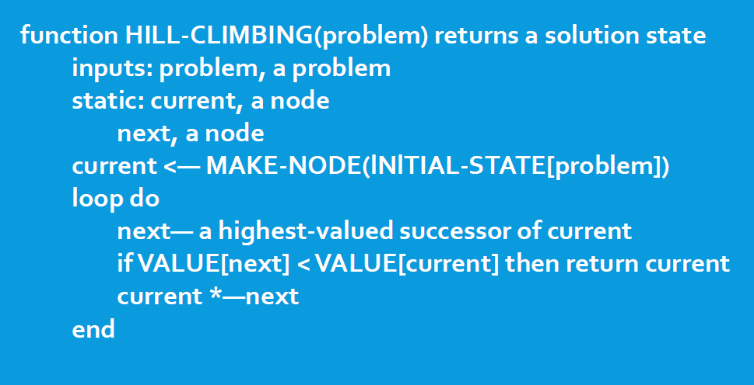
Hill Climbing Algorithm

Slide 10
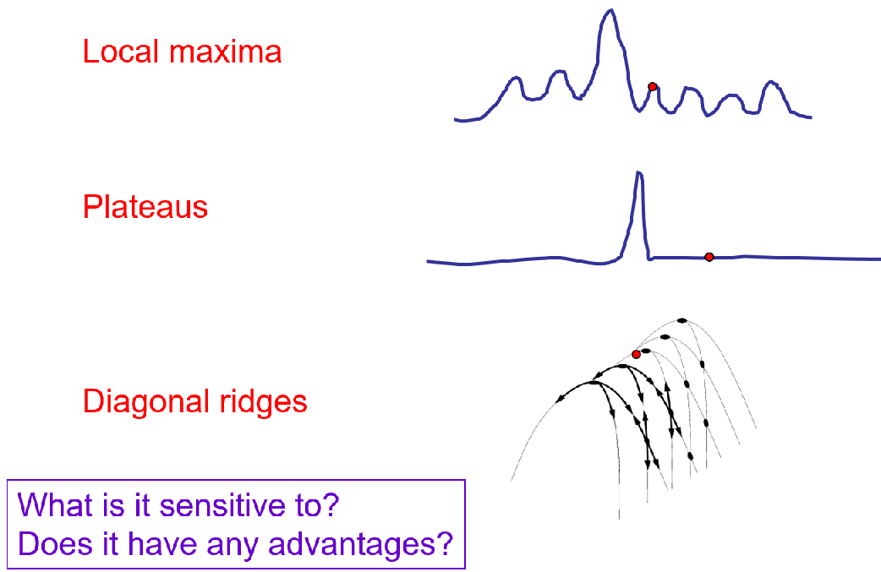
Hill Climbing Problems

Slide 11
Solving the Problems
Allow backtracking (What happens to complexity?)
Stochastic hill climbing: choose at random from uphill moves, using steepness for a probability
Random restarts: “If at first you don’t succeed, try, try again.”
Several moves in each of several directions, then test
Jump to a different part of the search space

Slide 12
Simulated Annealing (1)
Variant of hill climbing (so up is good)
Tries to explore enough of the search space early on, so that the final solution is less sensitive to the start state
May make some downhill moves before finding a good way to move uphill.

Slide 13
Simulated Annealing (2)
Comes from the physical process of annealing in which substances are raised to high energy levels (melted) and then cooled to solid state.
The probability of moving to a higher energy state, instead of lower is
p = e^(-ΔE/kT)
where ΔE is the positive change in energy level, T is the temperature, and k is Bolzmann’s constant.
heat cool

Slide 14
Simulated Annealing (3)
At the beginning, the temperature is high.
As the temperature becomes lower
kT becomes lower
ΔE/kT gets bigger
(-ΔE/kT) gets smaller
e^(-ΔE/kT) gets smaller
As the process continues, the probability of a downhill move gets smaller and smaller.

Slide 15
For Simulated Annealing
ΔE represents the change in the value of the objective function.
Since the physical relationships no longer apply, drop k. So p = e^(-ΔE/T)
We need an annealing schedule, which is a sequence of values of T: T₀, T₁, T₂, ...

Slide 16
Simulated Annealing Algorithm
current ← start node;
for each T on the schedule /* need a schedule */
next ← randomly selected successor of current
evaluate next; it it’s a goal, return it
ΔE ← next.Value – current.Value /* already negated */
if ΔE > 0
then current ← next /* better than current */
else current ← next with probability e^(ΔE/T)
How would you do this probabilistic selection?

Slide 17
Probabilistic Selection
Select next with probability p
Generate a random number
If it’s <= p, select next
p
0 1
random
number

Slide 18
Simulated Annealing Properties
At a fixed “temperature” T, state occupation probability reaches the Boltzman distribution
If T is decreased slowly enough (very slowly), the procedure will reach the best state.
Slowly enough has proven too slow for some researchers who have developed alternate schedules.
p(x) = αe^(E(x)/kT)

Slide 19
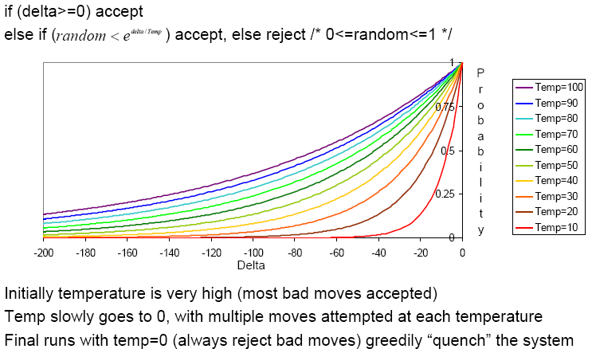
Simulated Annealing Schedules
Acceptance criterion and cooling schedule

Slide 20
Simulated Annealing Applications
Basic Problems
Traveling salesman
Graph partitioning
Matching problems
Graph coloring
Scheduling
Engineering
VLSI design
Placement
Routing
Array logic minimization
Layout
Facilities layout
Image processing
Code design in information theory

Slide 21
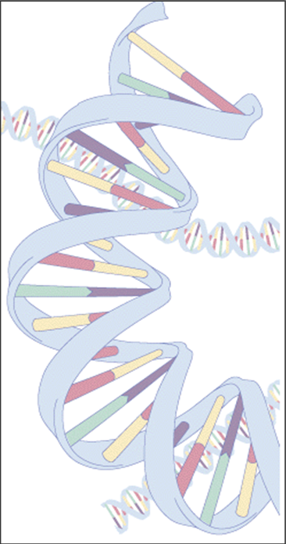
Genetic Algorithm (1)
Follows steps inspired by the biological processes of evolution.
Follow the idea of SURVIVAL OF THE FITTEST- Better and better solutions evolve from previous generations until a near optimal solution is obtained.

Slide 22
Genetic Algorithm (2)
Genetic Algorithms are often used to improve the performance of other AI methods.
The method learns by producing offspring that are better and better as measured by a fitness function.

Slide 23
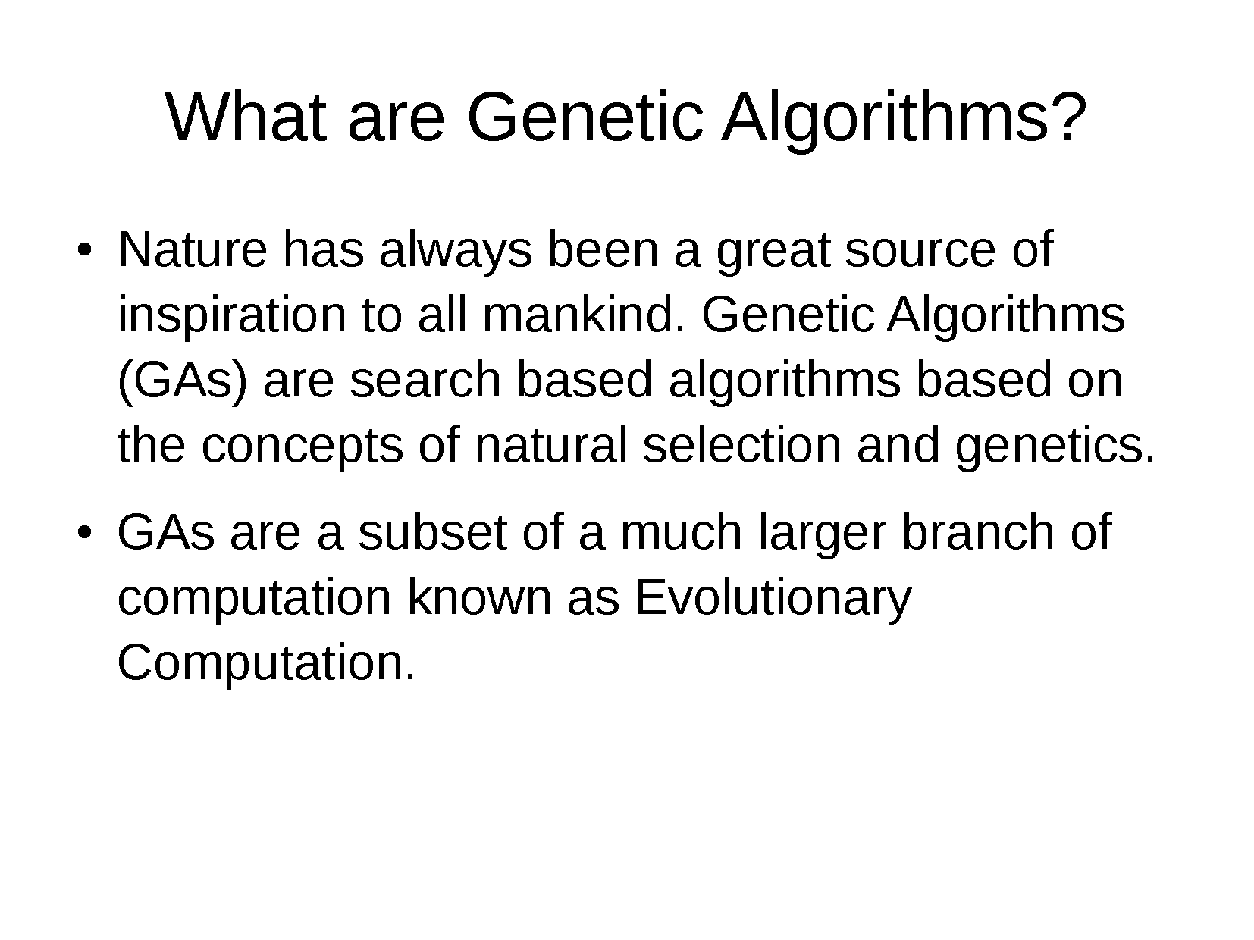

Slide 24
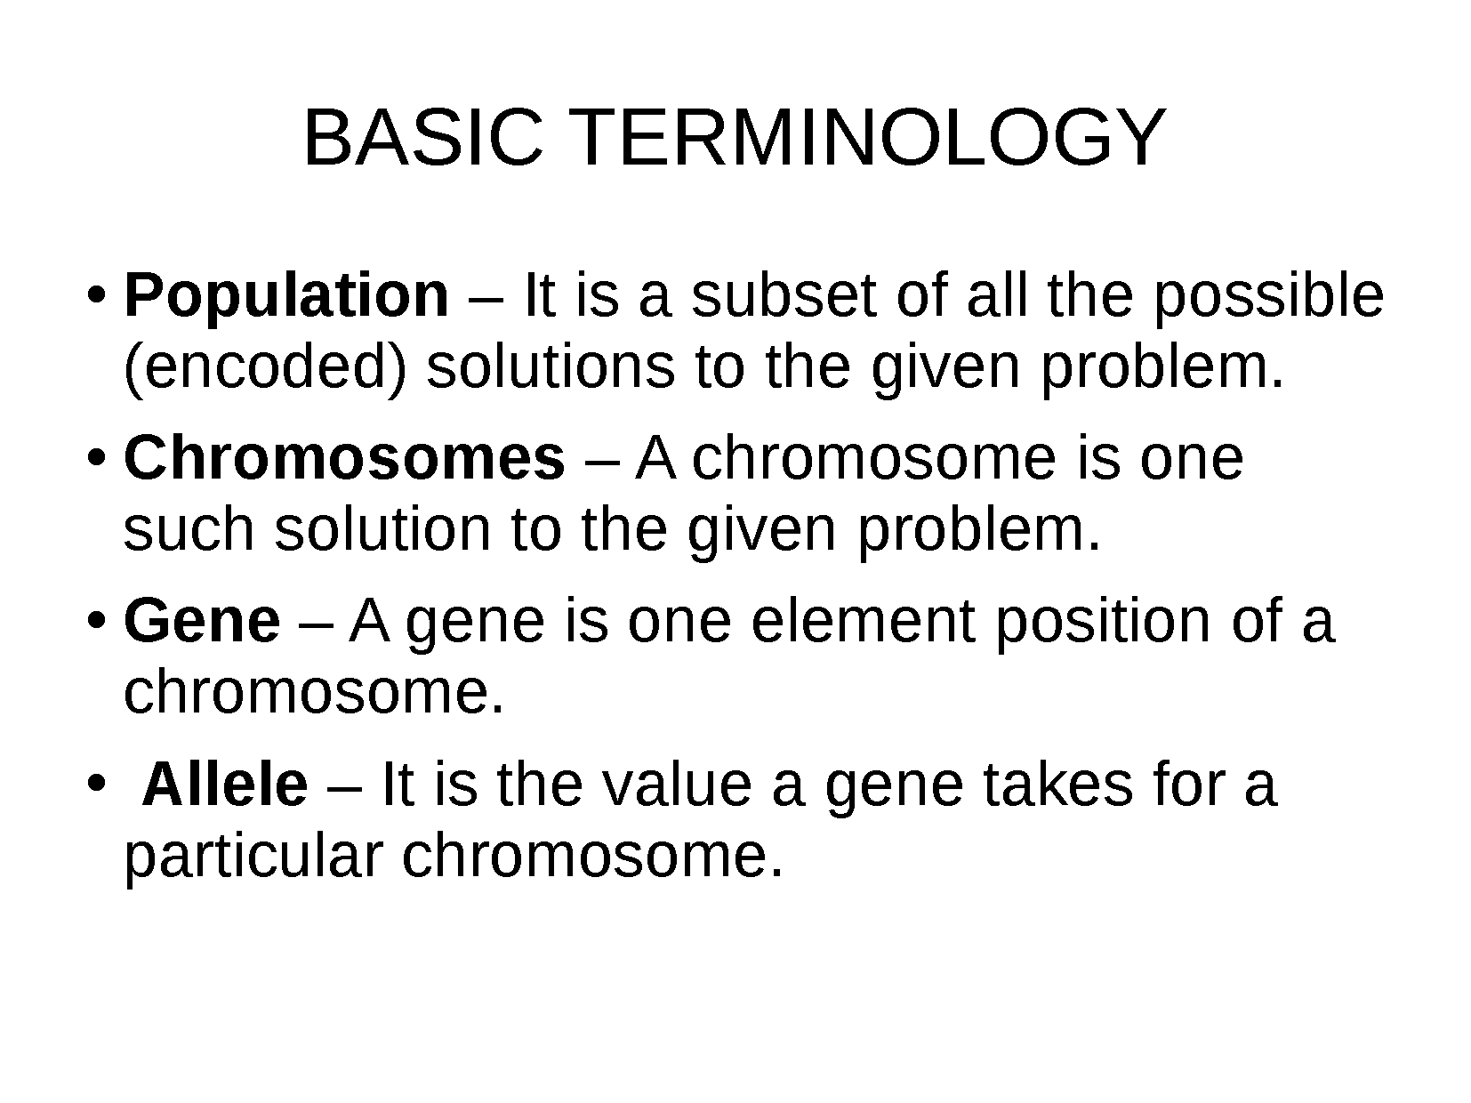

Slide 25
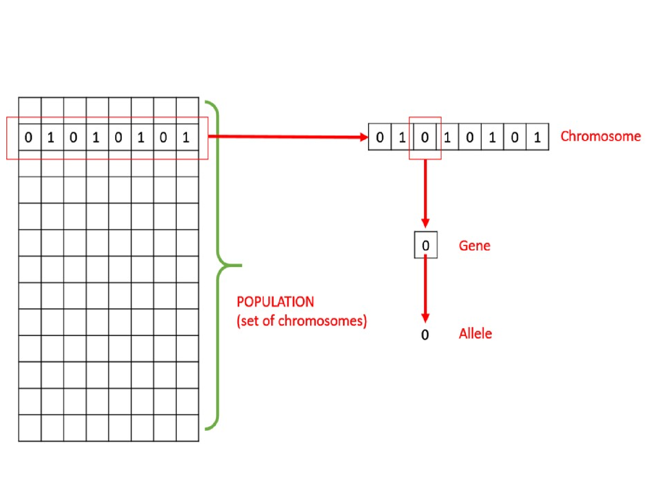

Slide 26
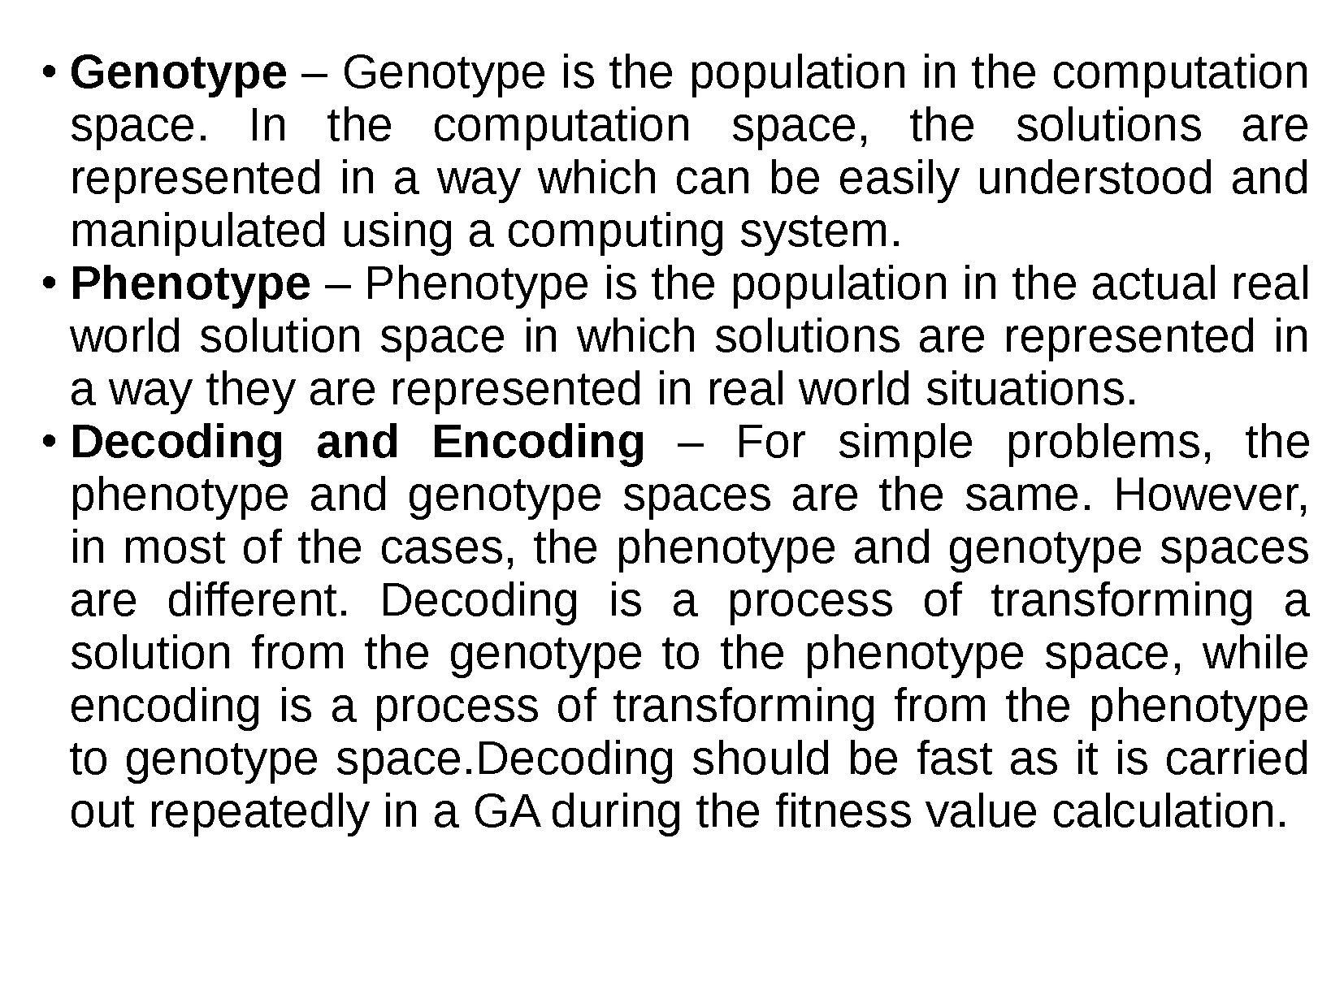

Slide 27
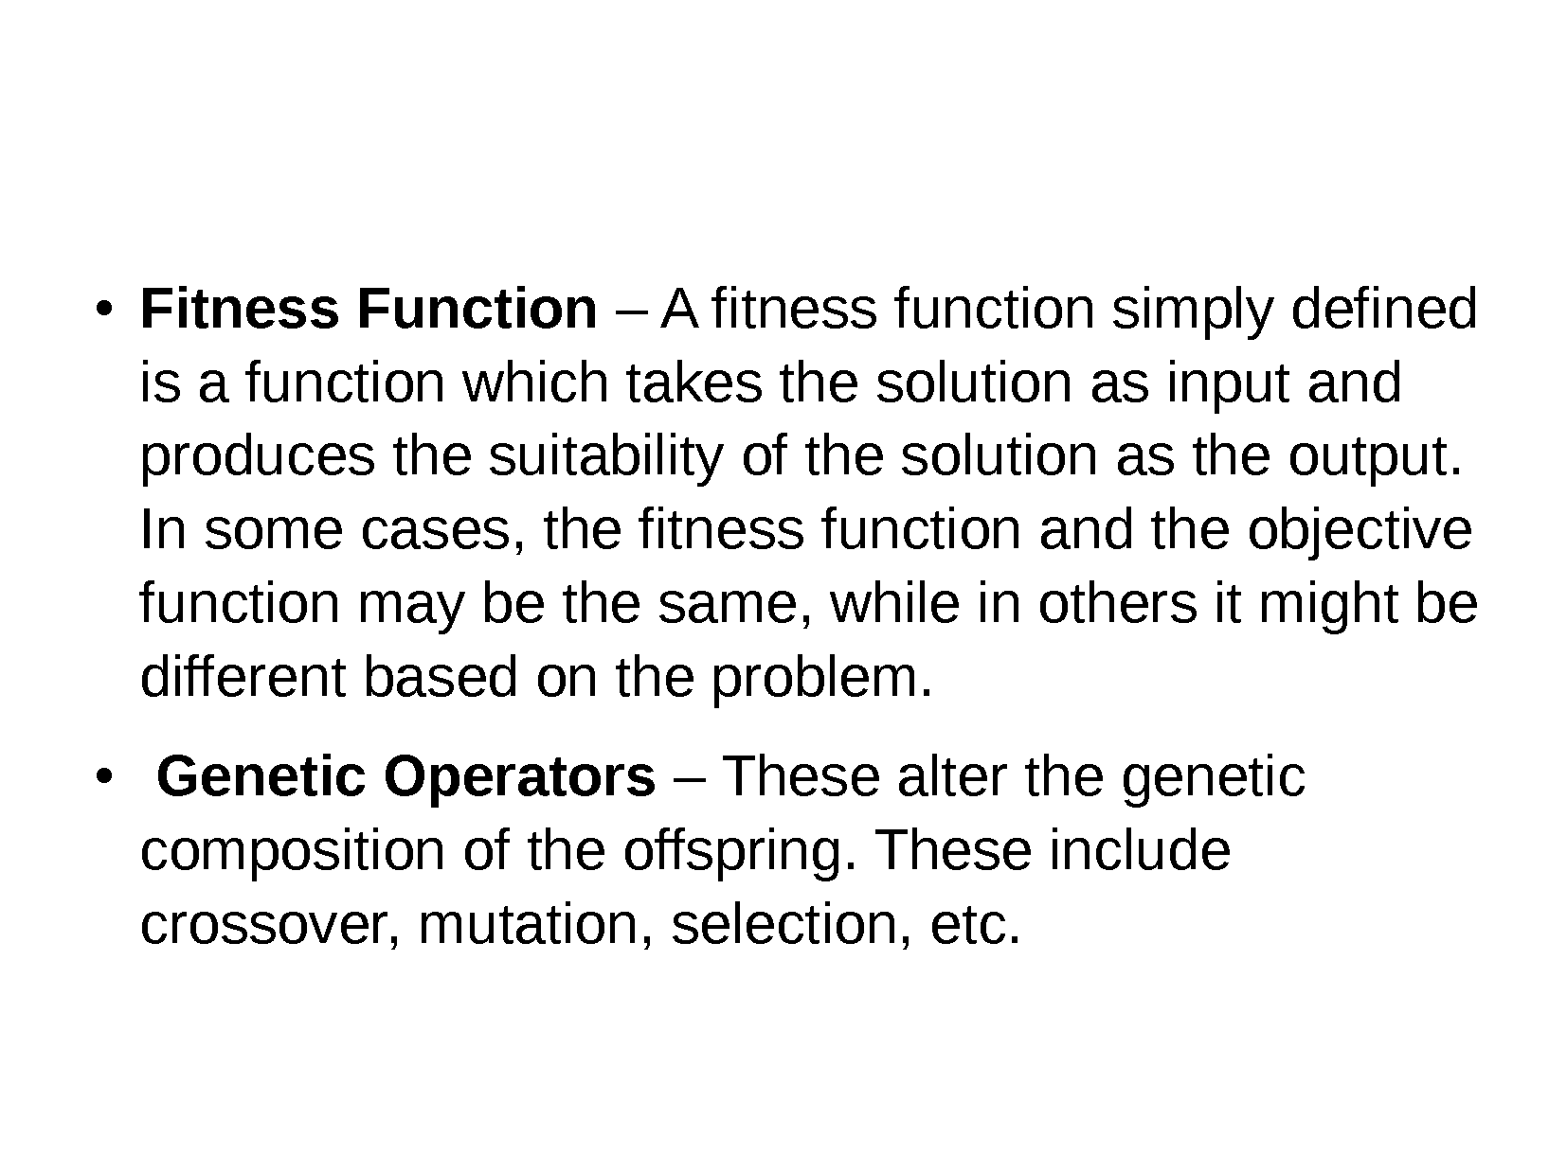

Slide 28
Knapsack Problem (1)
You are going on a picnic.
And have a number of items that you could take along.
Each item has a weight and a benefit or value.
You can take one of each item at most.
There is a capacity limit on the weight you can carry.
You should carry items with max. values.

Slide 29
Knapsack Problem (2): Example
Item: 1 2 3 4 5 6 7
Benefit: 5 8 3 2 7 9 4
Weight: 7 8 4 10 4 6 4
Knapsack holds a maximum of 22 pounds
Fill it to get the maximum benefit

Slide 30
Genetic Algorithm :Outline
[Start]
Encoding: represent the individual.
Generate random population of n chromosomes (suitable solutions for the problem).
[Fitness] Evaluate the fitness of each chromosome.
[New population] repeating following steps until the new population is complete.
[Selection] Select the best two parents.
[Crossover] cross over the parents to form a new offspring (children).

Slide 31
Genetic Algorithm: Outline
[Mutation] With a mutation probability.
[Accepting] Place new offspring in a new population.
[Replace] Use new generated population for a further run of algorithm.
[Test] If the end condition is satisfied, then stop.
[Loop] Go to step 2 .

Slide 32
Basic Steps (1)
START
Encoding: 0 = not exist, 1 = exist in the Knapsack
Chromosome: 1010110
=> Items taken: 1, 3 , 5, 6.
Generate random population of n chromosomes:
0101010
1100100
0100011
7 | 6 | 5 | 4 | 3 | 2 | 1 | Item.
0 | 1 | 1 | 0 | 1 | 0 | 1 | Chro
n | y | y | n | y | n | y | Exist?

Slide 33
Basic Steps (2)
Fitness & Selection
✗
0101010: Benefit= 19, Weight= 24
1100100: Benefit= 20, Weight= 19.
0100011: Benefit= 21, Weight= 18.
7 | 6 | 5 | 4 | 3 | 2 | 1 | Item
0 | 1 | 0 | 1 | 0 | 1 | 0 | Chro
4 | 9 | 7 | 2 | 3 | 8 | 5 | Benefit
4 | 6 | 4 | 10 | 4 | 8 | 7 | Weight
✓
✓
=> We select Chromosomes b & c.

Slide 34
Basic Steps (3)
Crossover & Mutation
Parent 1
1 1 0 0 1 0 0
Parent 2
0 1 0 0 0 1 1
Child 1
1 1 0 0 0 1 1
Child 2
0 1 0 0 1 0 1
Mutation
0 1 0 0 1 0 0

Slide 35
Basic Steps (4)
Accepting, Replacing & Testing
Place new offspring in a new population.
Use new generated population for a further run of algorithm.
If the end condition is satisfied, then stop. End conditions:
Number of populations.
Improvement of the best solution.
Else, return to step 2 [Fitness].

Slide 36
Some More Understanding on Knapsack Problem

Slide 37
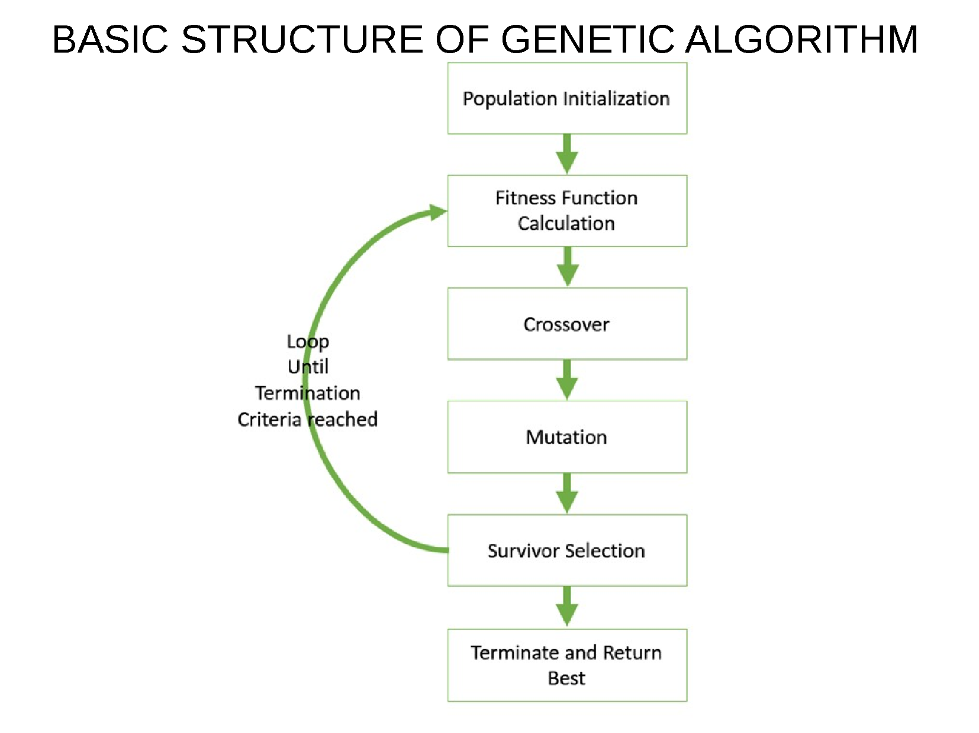

Slide 38
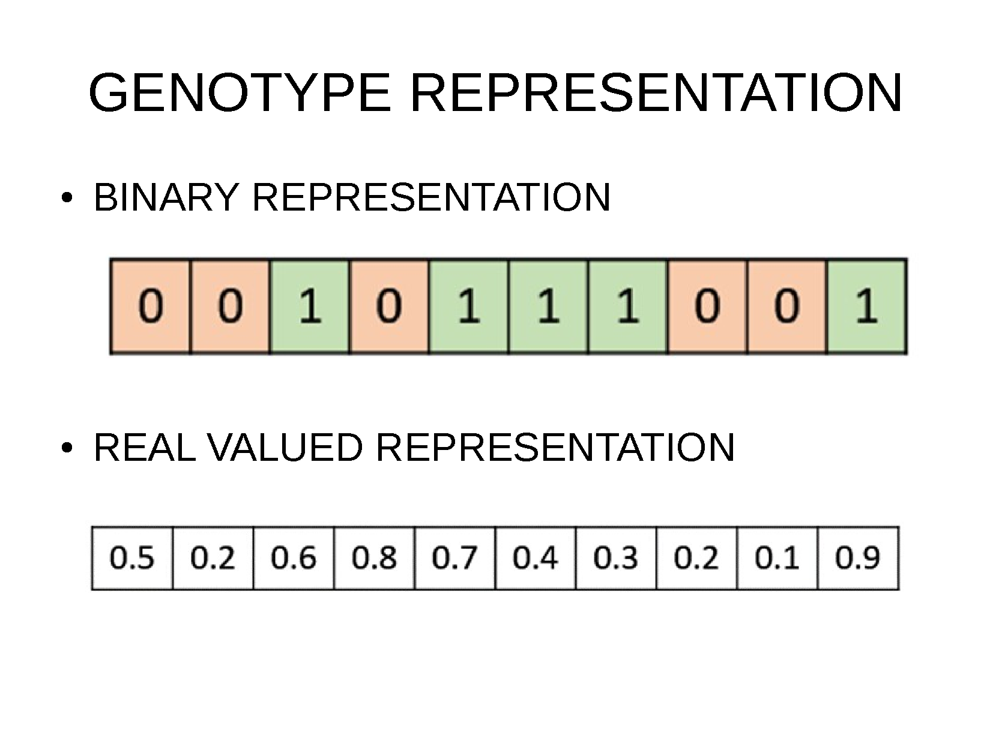

Slide 39
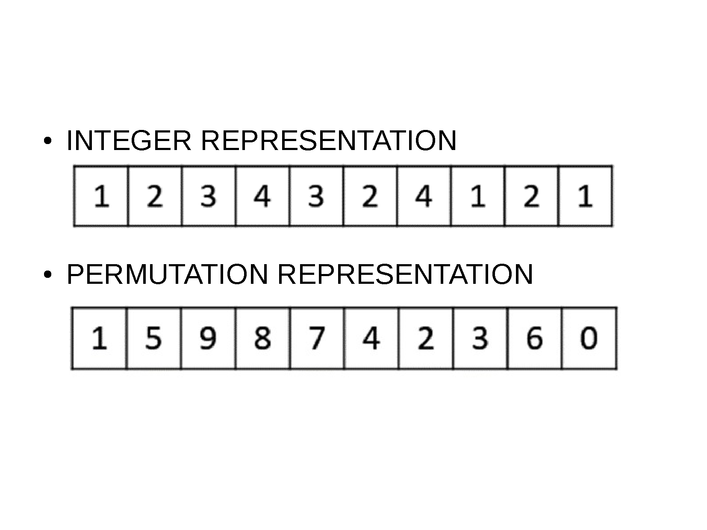

Slide 40
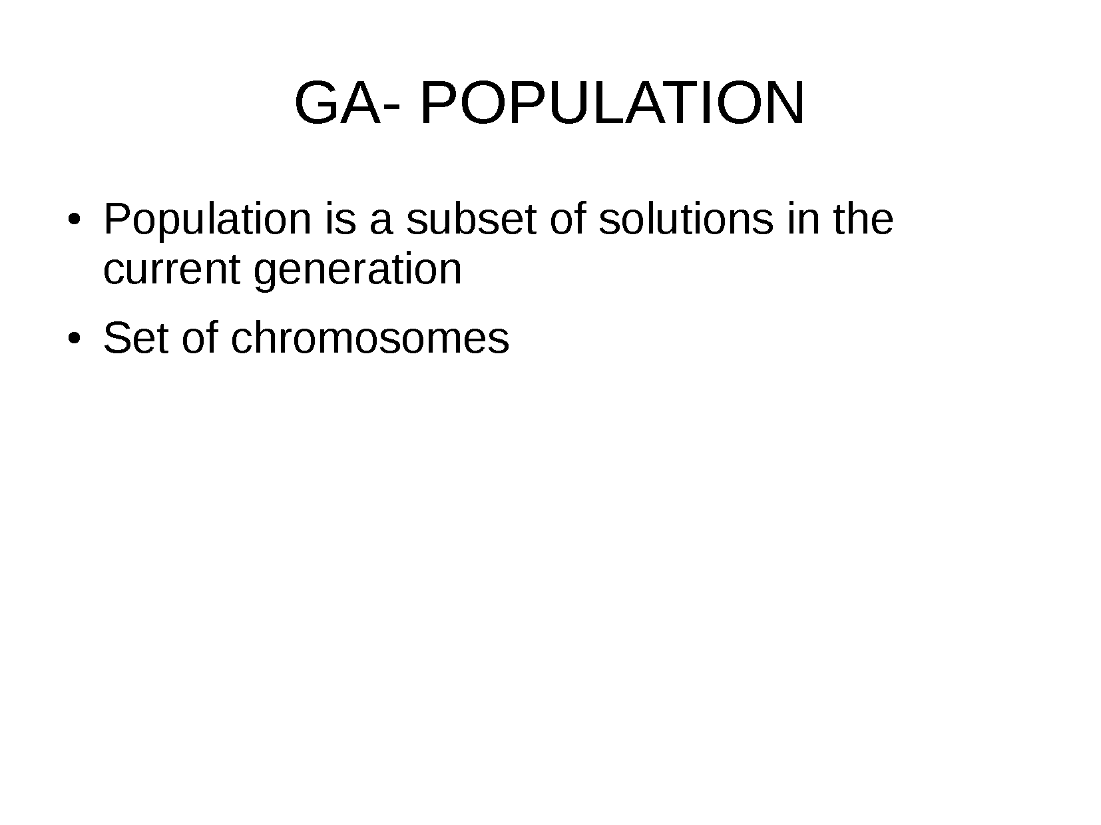

Slide 41
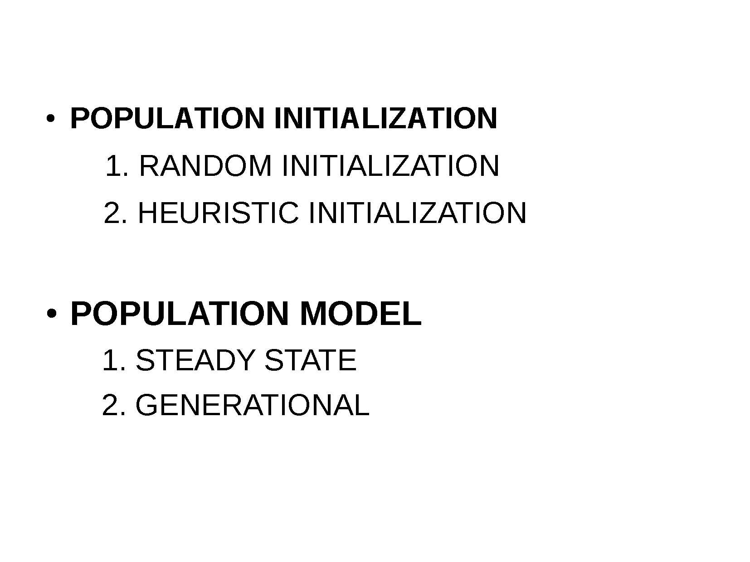

Slide 42
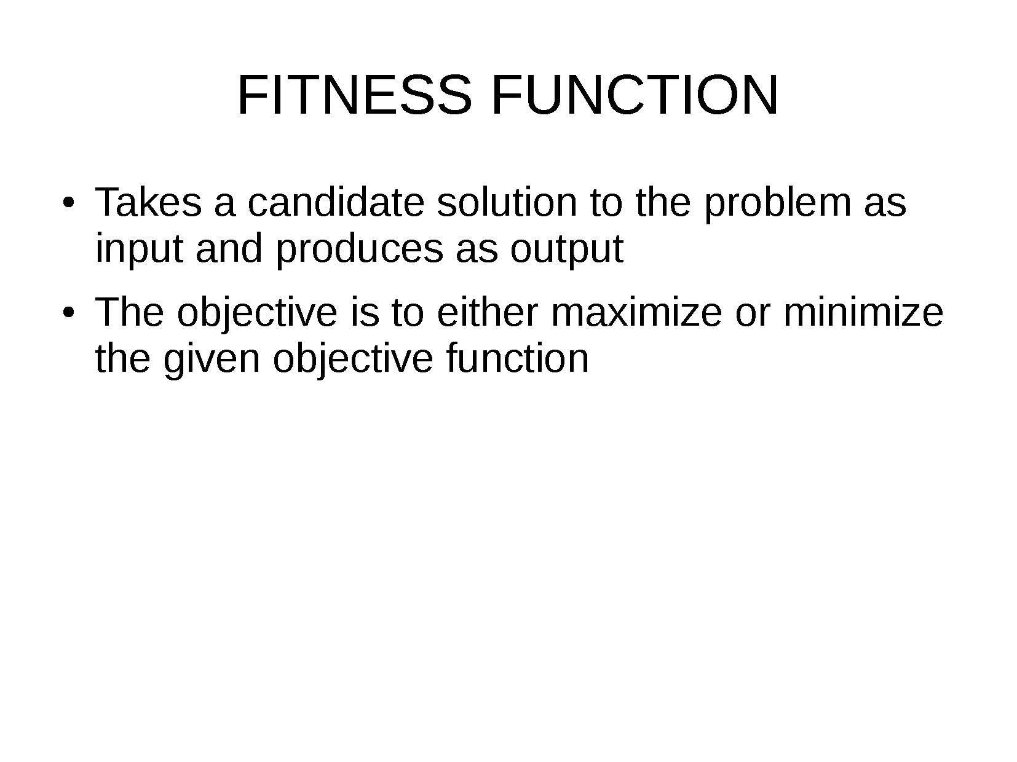

Slide 43
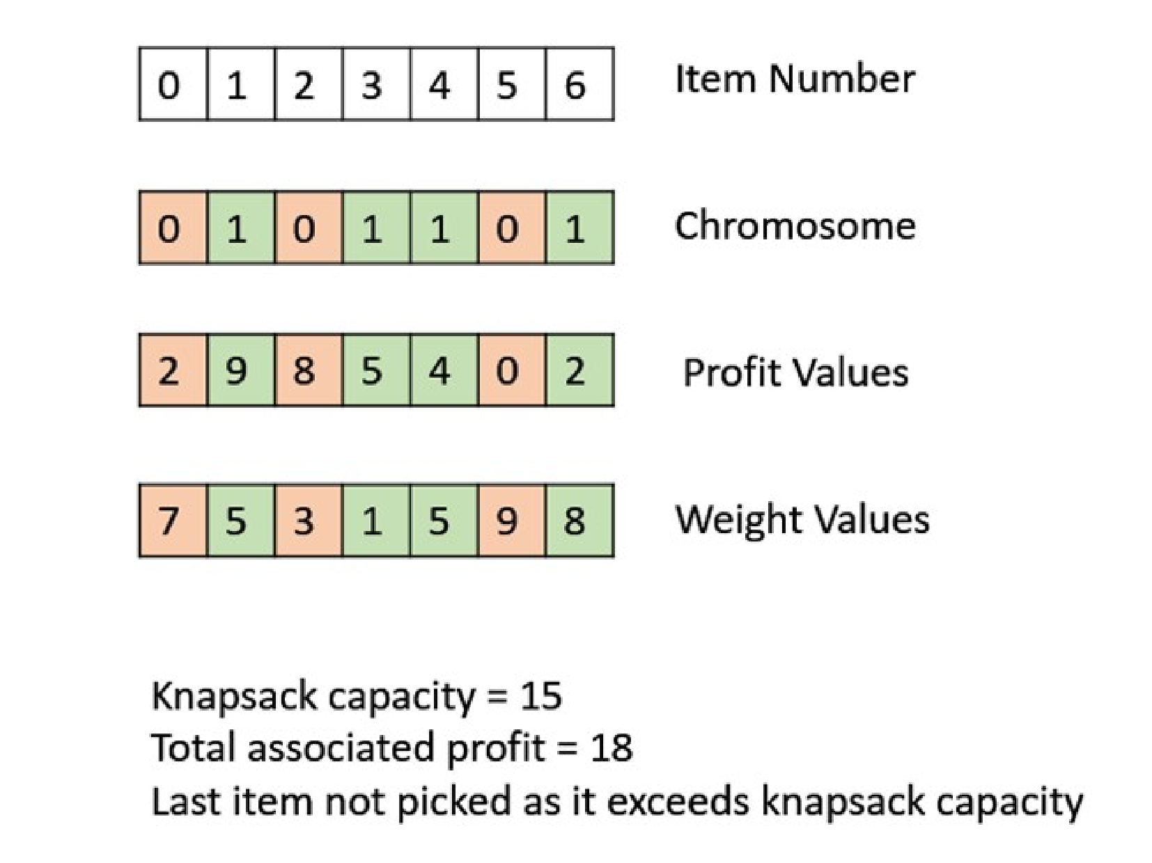

Slide 44
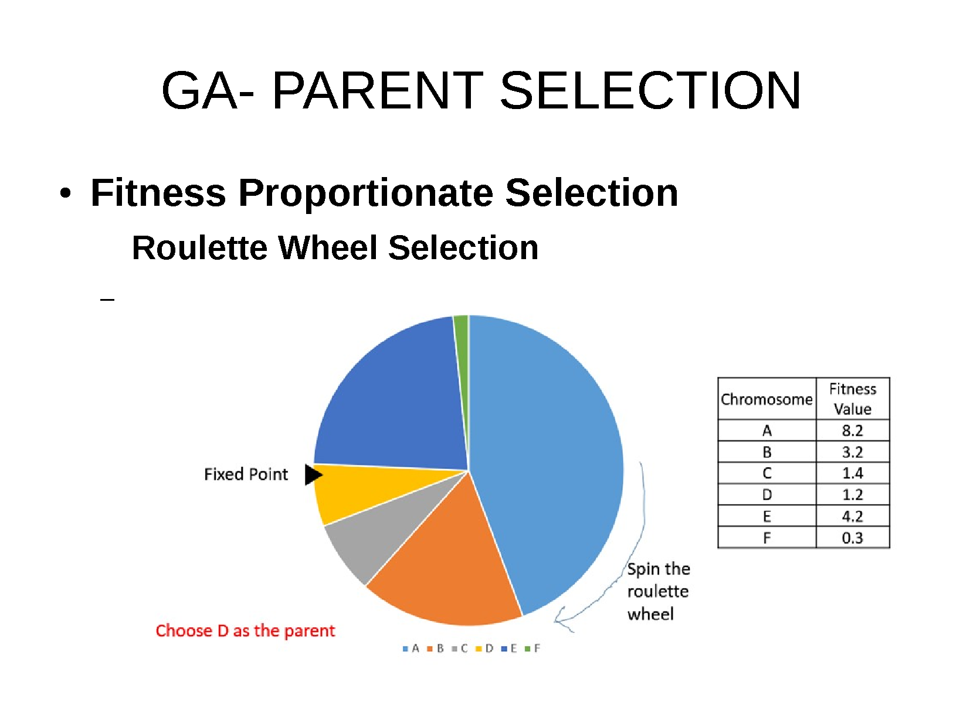

Slide 45
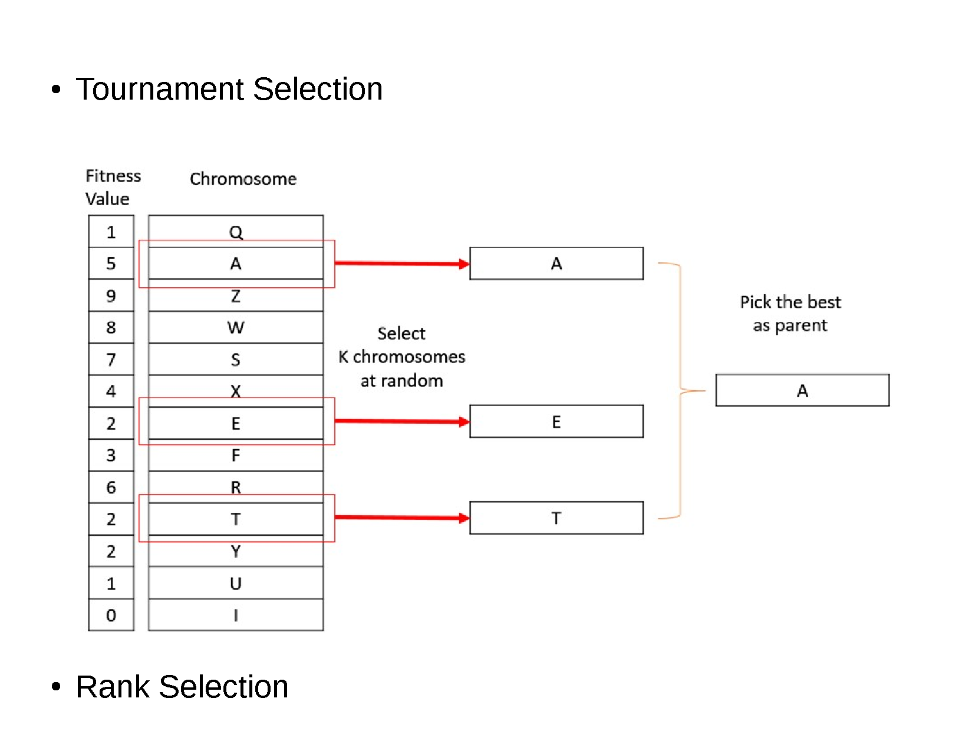

Slide 46
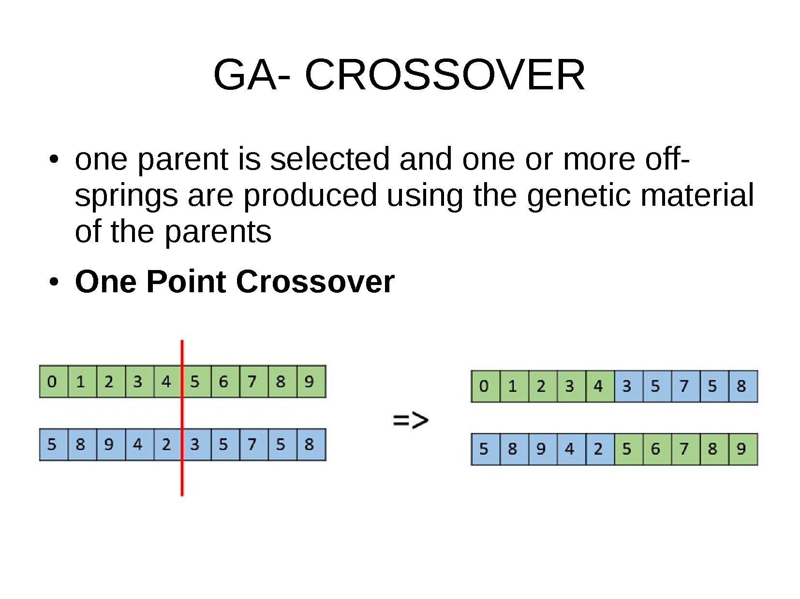

Slide 47
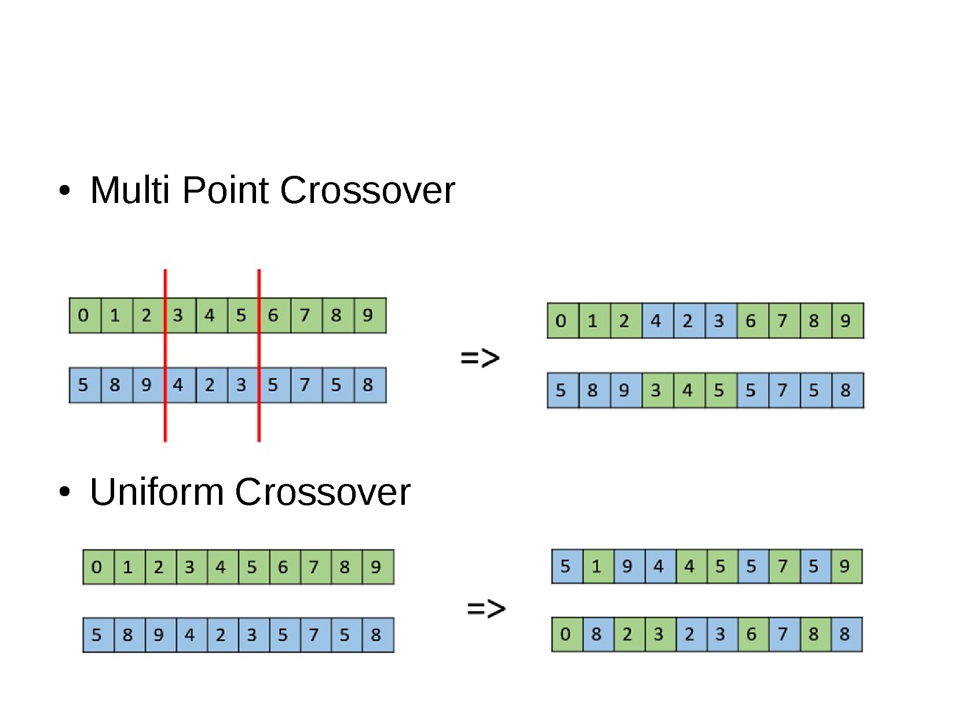

Slide 48
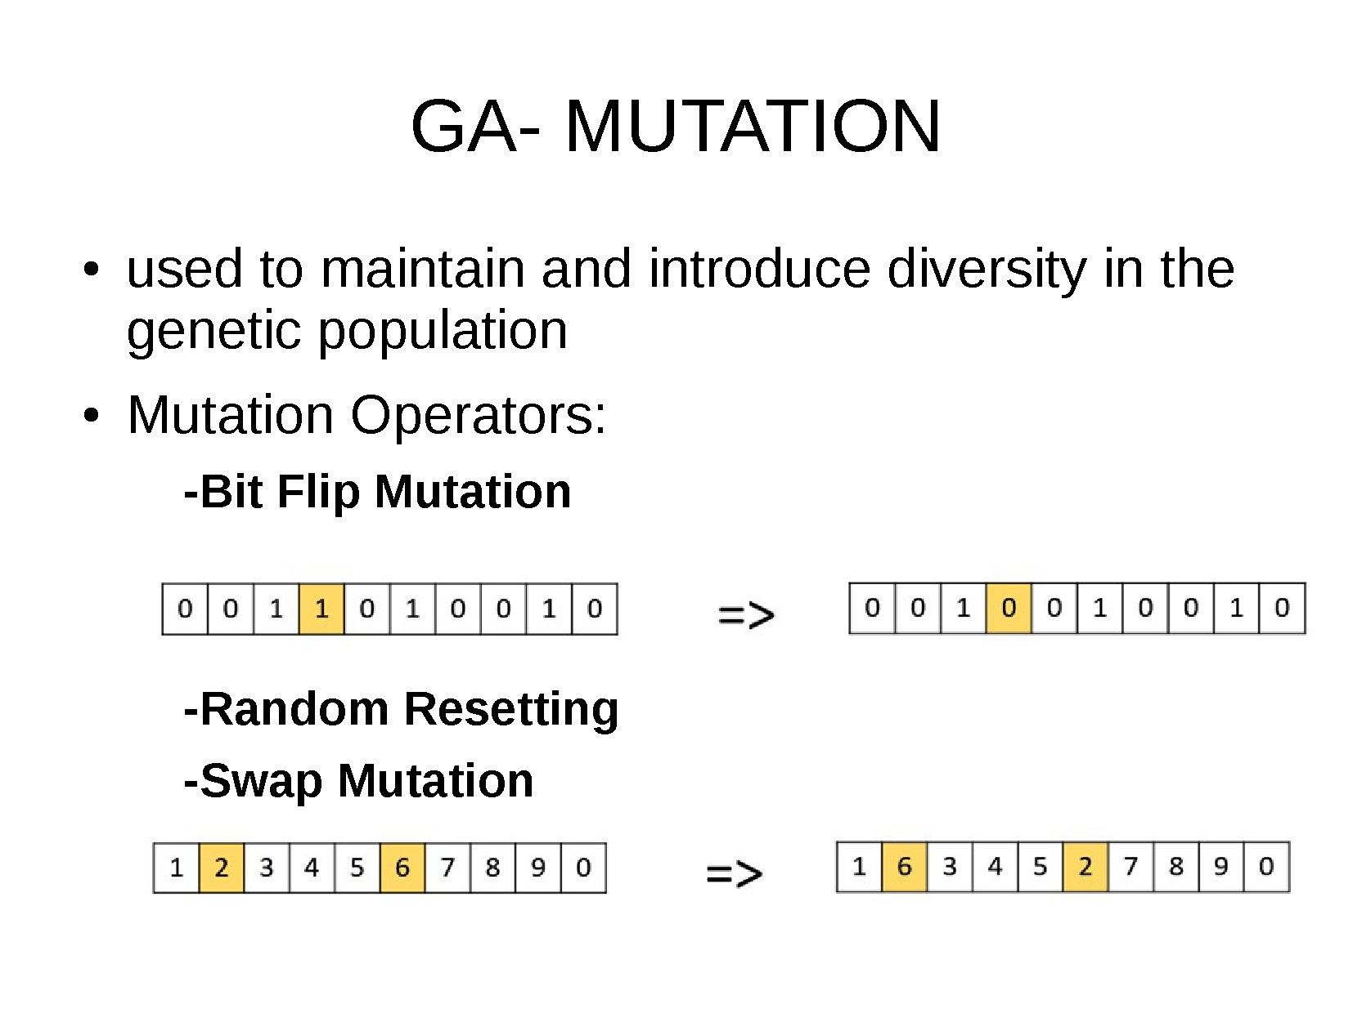

Slide 49
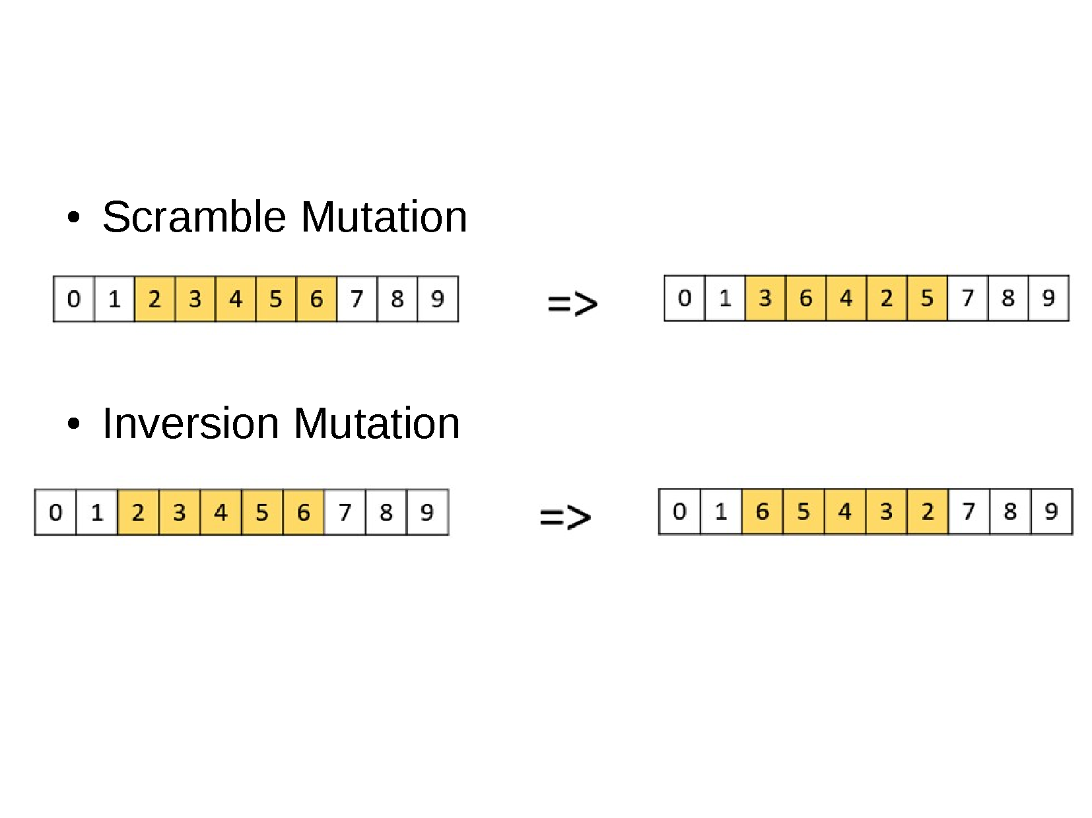

Slide 50
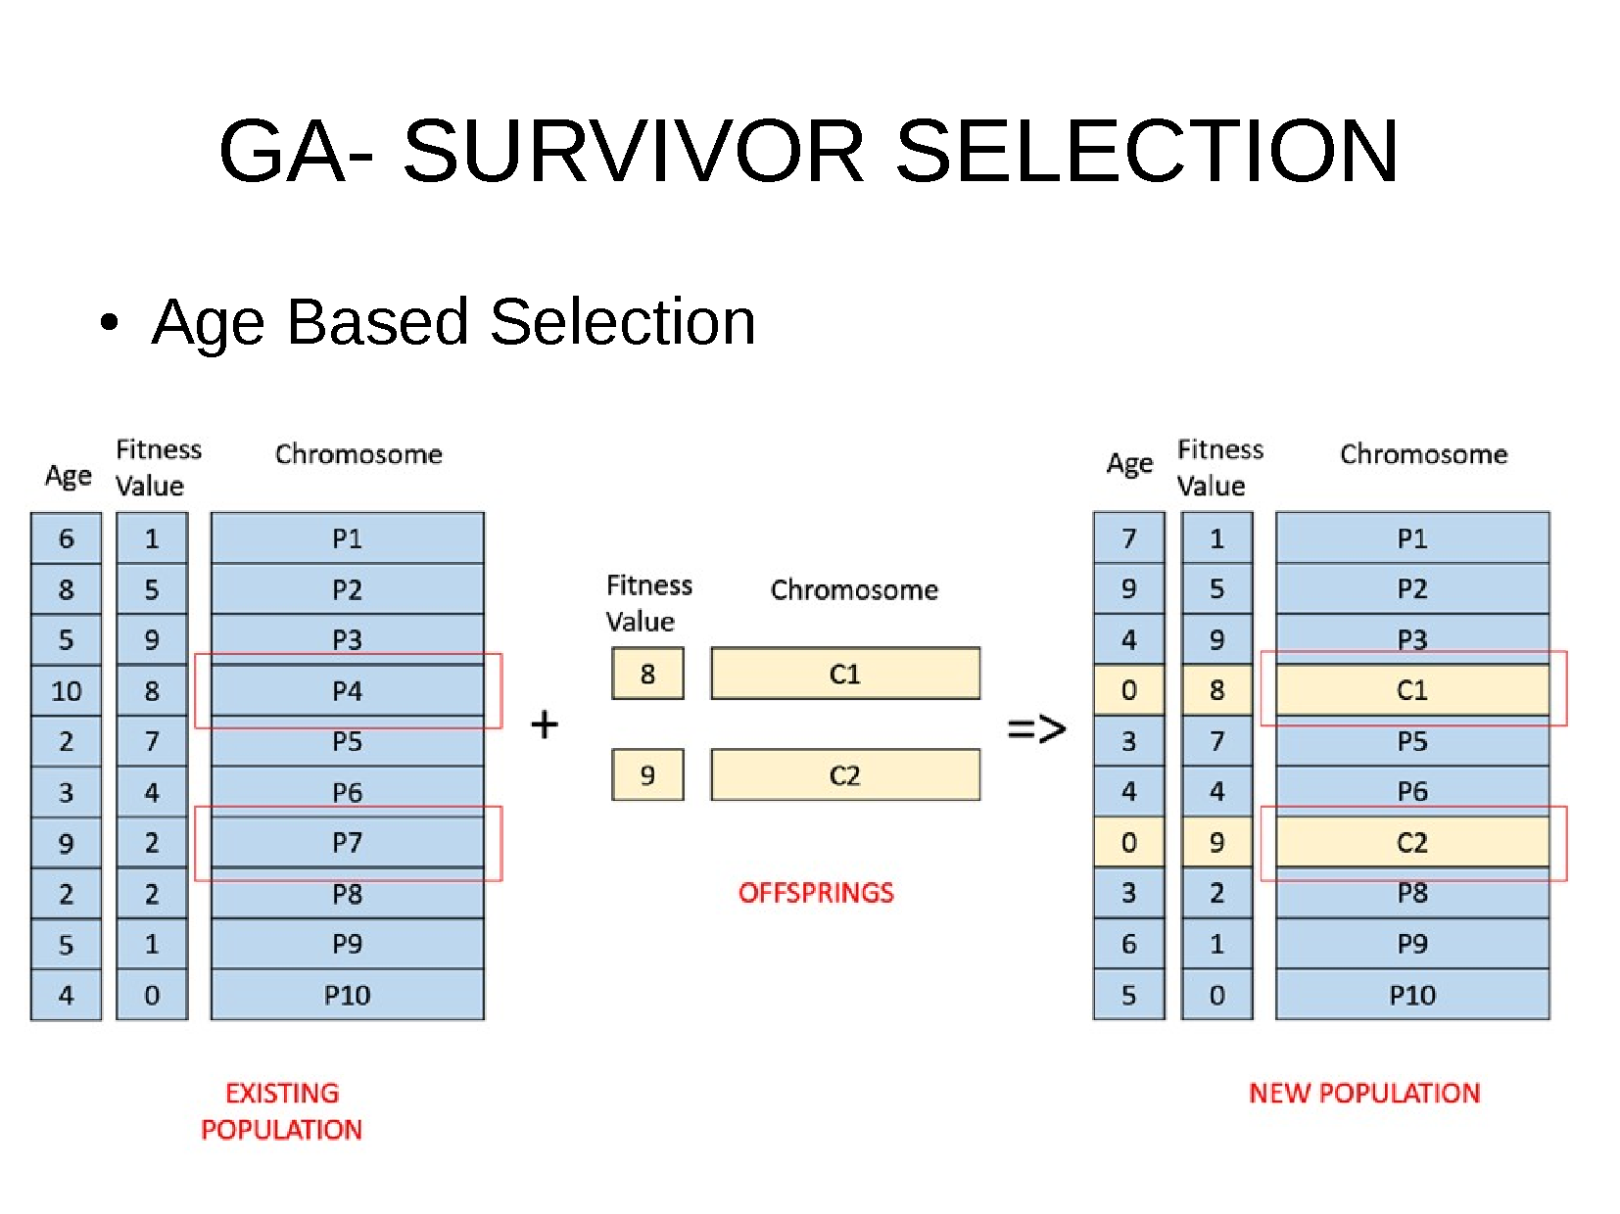

Slide 51
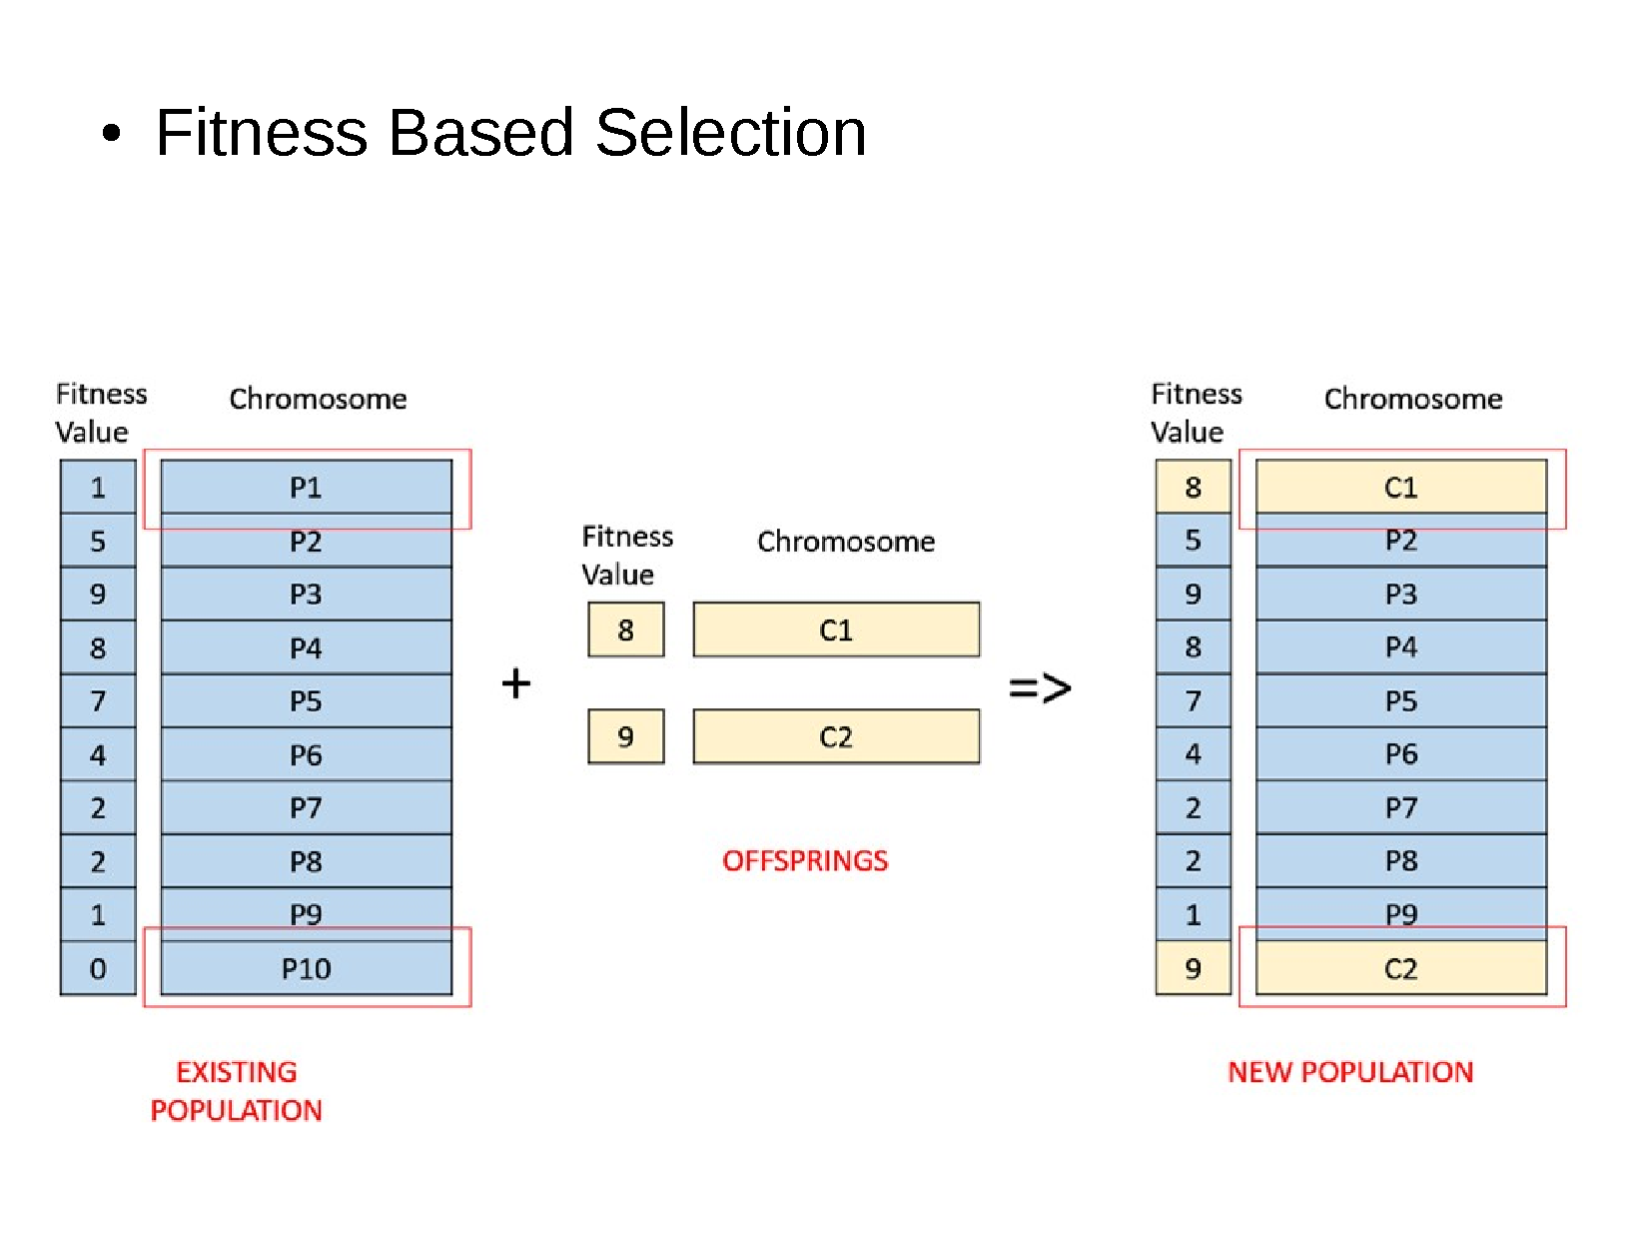

Slide 52
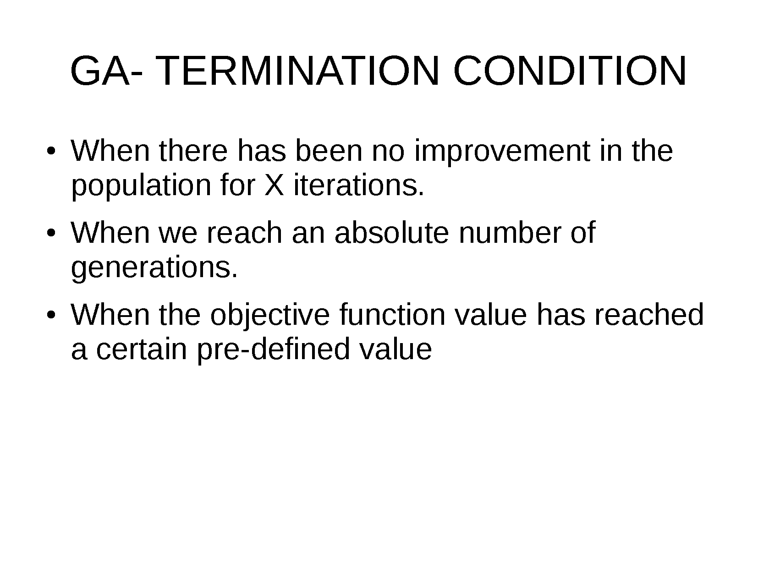

Slide 53
Learning Outcomes with the Topic
Understanding the need of Local Optimisations in Search Algorithms

Slide 54
Methodology And Assessment Criterias
Class Assignment(s)
Each chapter being covered will have one assignment. The Case Studies will be given in line to the Changing with Speed across IT Projects in Kirirom
Internal Exam(s)
There will be 2 exams
Model Exam
There will be one Model Exam.
Semester Exam
There will be 1 Semester Exam

Slide 55
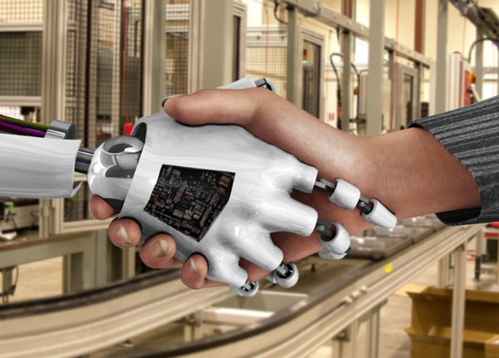
Thank You !
“An Algorithm Must Be Seen to Be Believed”
- Donald Knuth

